Slide 1
Classifying Dog and Cat Images using Machine Learning
TJ Nguyen

Slide 2
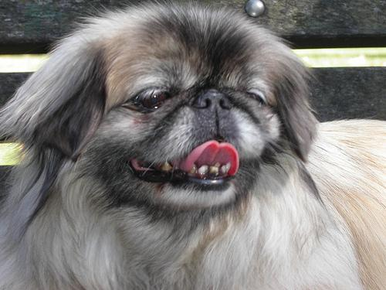
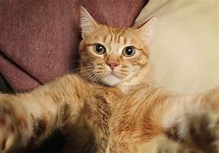
Domain: Image Classification
Machine learning to do image classification.
This is not a domain I am working in but I found it very interesting.
I chose dogs and cats because the images were easy to obtain and I like animals!

Slide 3

Tensorflow and Keras
TensorFlow is a free and open-source software library for dataflow. It is also used for machine learning applications such as neural networks.
They are both machine learning libraries.
Keras is a wrapper for tensorflow.

Slide 4
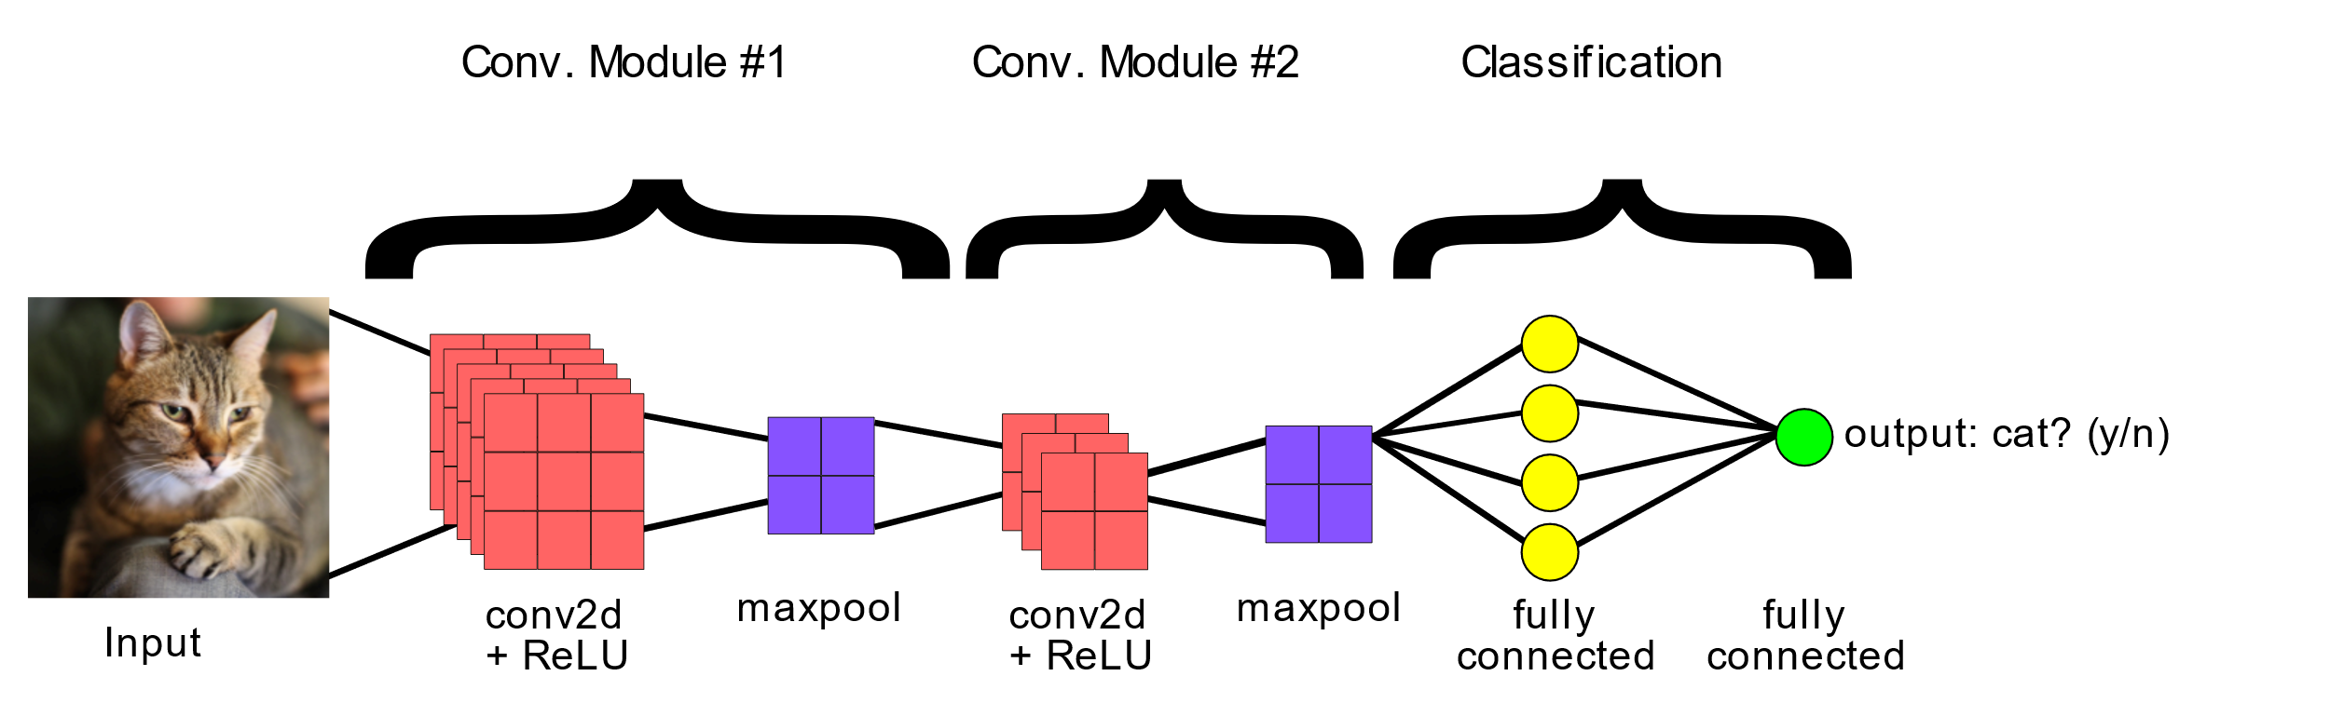
Classifying Dog and Cat Images
Finding the data from Kaggle
Split the images in training and testing data
Create a convolutional neural network model from available layers
Compile the model and train with training data.
Predict the testing data.

Slide 5
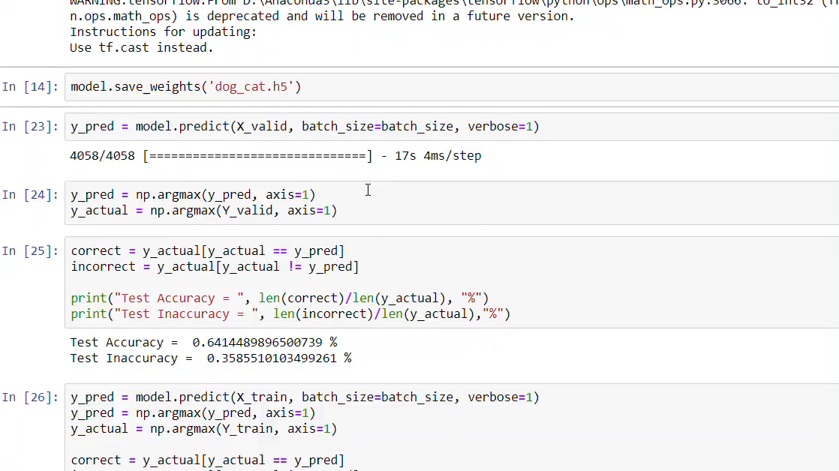


Slide 6
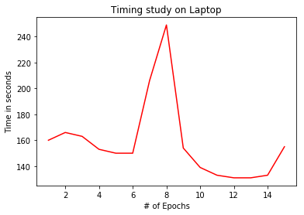
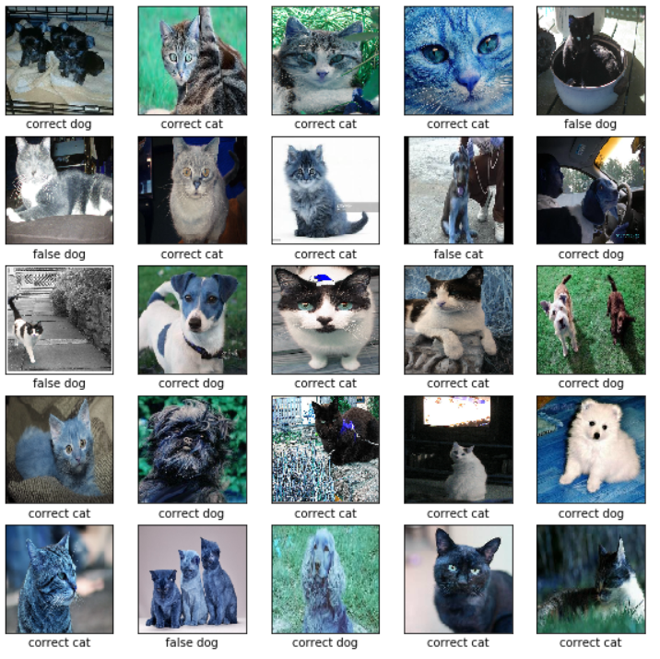
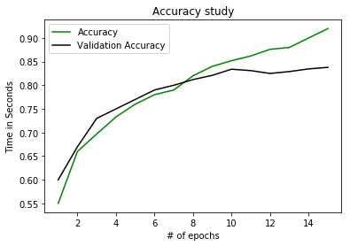
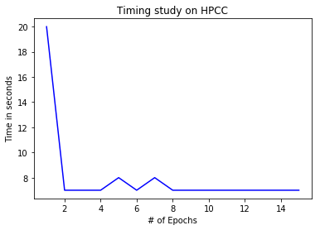
Results
90% training accuracy
84% testing accuracy

Slide 7
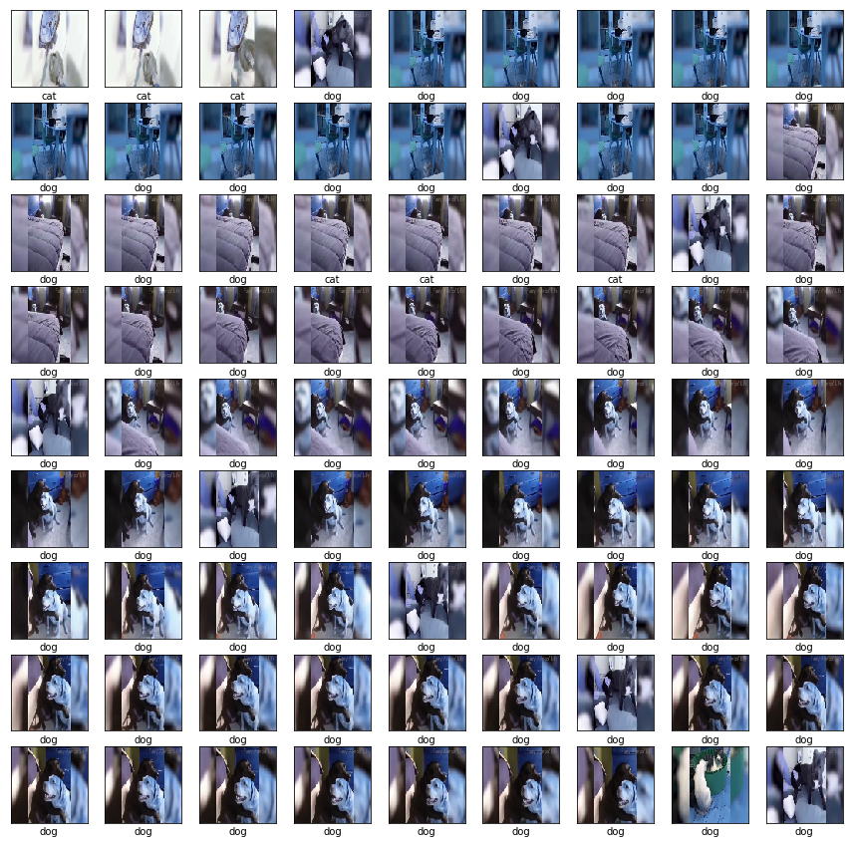
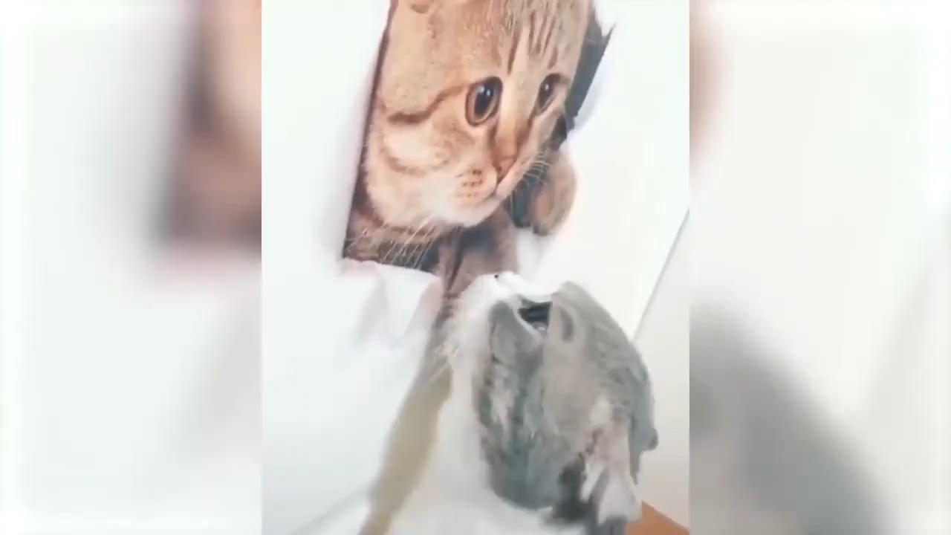
Classifying dogs and cats in videos
Convert video in images
Try to predict using those images

Slide 8
What I learned
Machine learning
Working with layers in a neural network
How to train a neural network
Converting video into images

